Slide 1
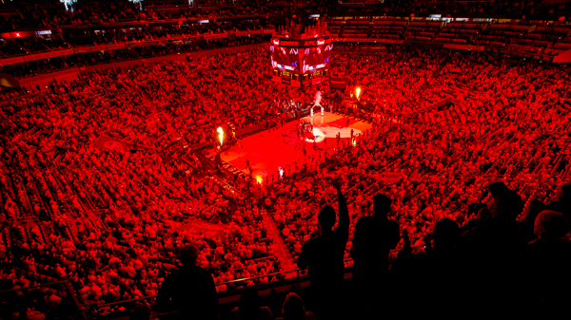
UNIVERSITY OF LOUISVILLE MEN’S BASKETBALL TEAM
INCEPTION PHASE PRESENTATION
THE BACKYARDIGANS

Slide 2

OVERVIEW
OVERVIEW
AS-IS PROCESS MODEL
TO-BE PROCESS MODEL
ECONOMIC FEASIBILITY
PRODUCT FEATURES
PROTOTYPE

Slide 3
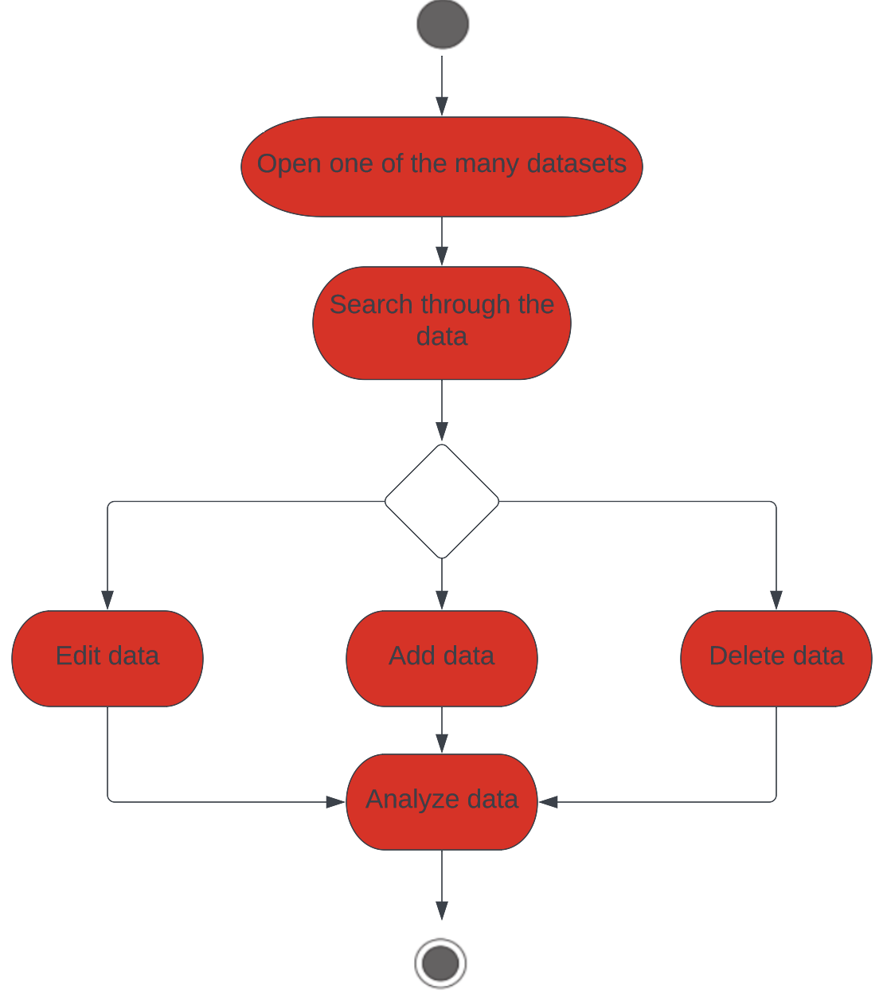
Process models: as-is Information Storage & Analysis Process

Slide 4
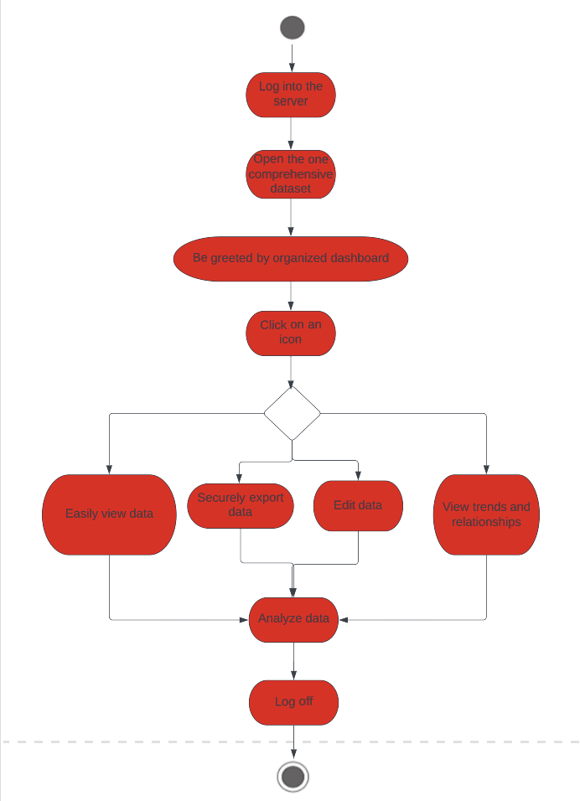
Process models: to-be Information Storage & Analysis Process

Slide 5
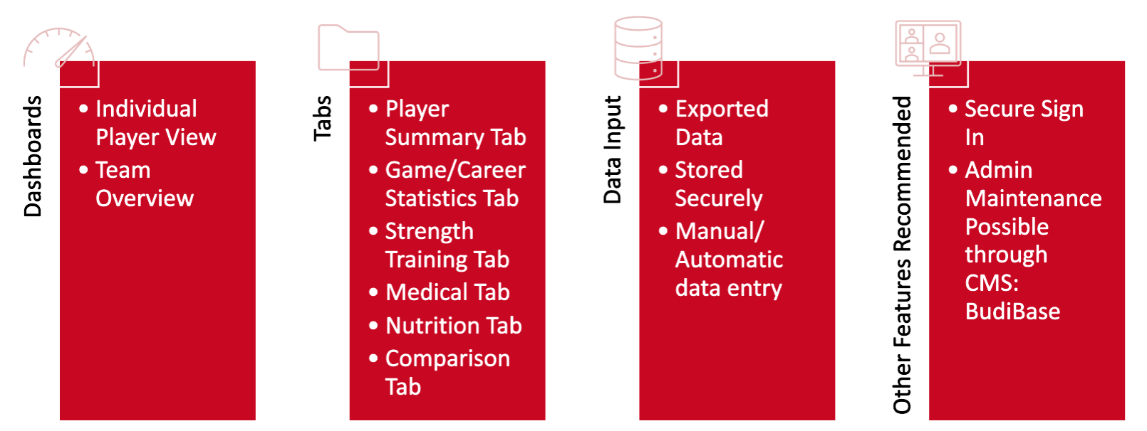
Product
features proposed features
of the new system

Slide 6
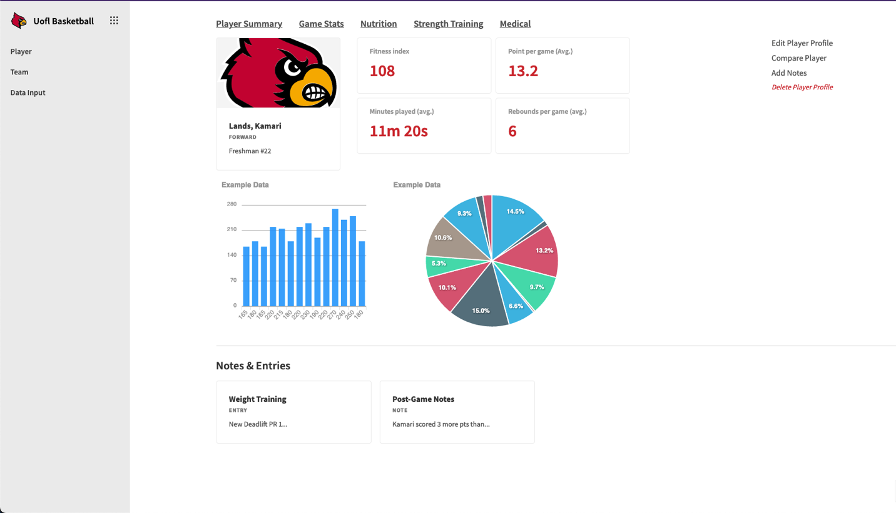
Product prototypes individual player dashboard
Test App

Slide 7
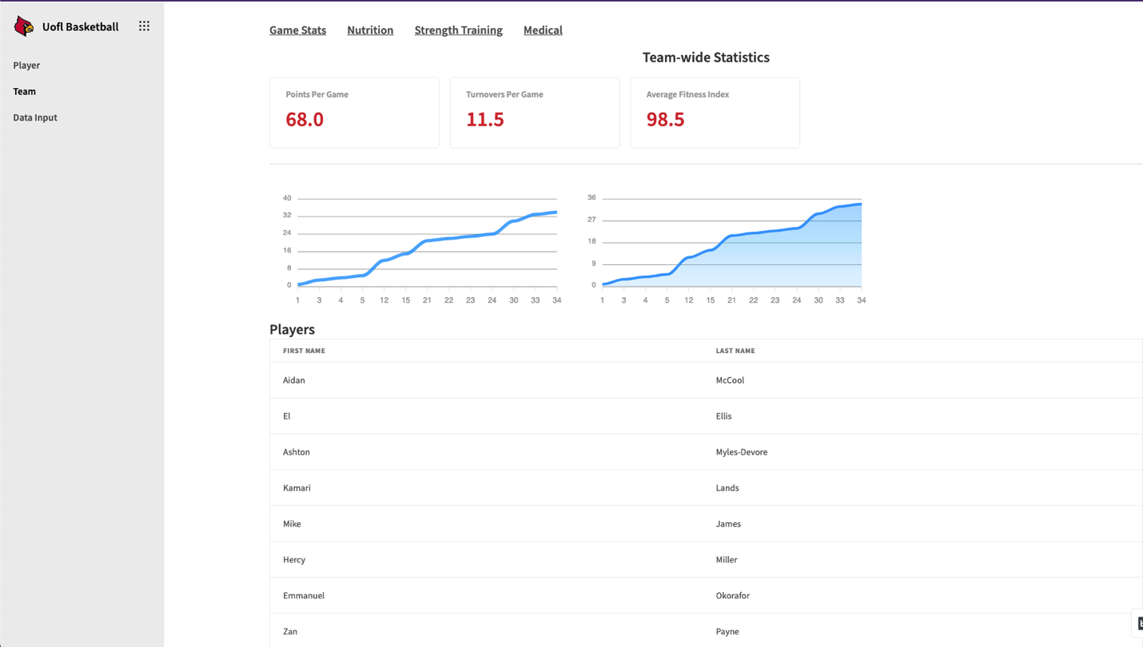
Product prototypes team dashboard

Slide 8
Conclusion inception phase wrap-up
Future Work
Limitations
Notably limited by the available data provided and formatting of that data
Questions?
Data Entry
Data Input Forms
Database Design
Comparisons & Visualizations

